Slide 1
Vaccines For Children
Joseph N. DiVincenzo, Jr., Essex County Executive
The Board of County Commissioners
Office of Public Health Management
Maya Lordo, M.S., MCHES, REHS, H.O.
Director/Health Officer of OPHM

Slide 2
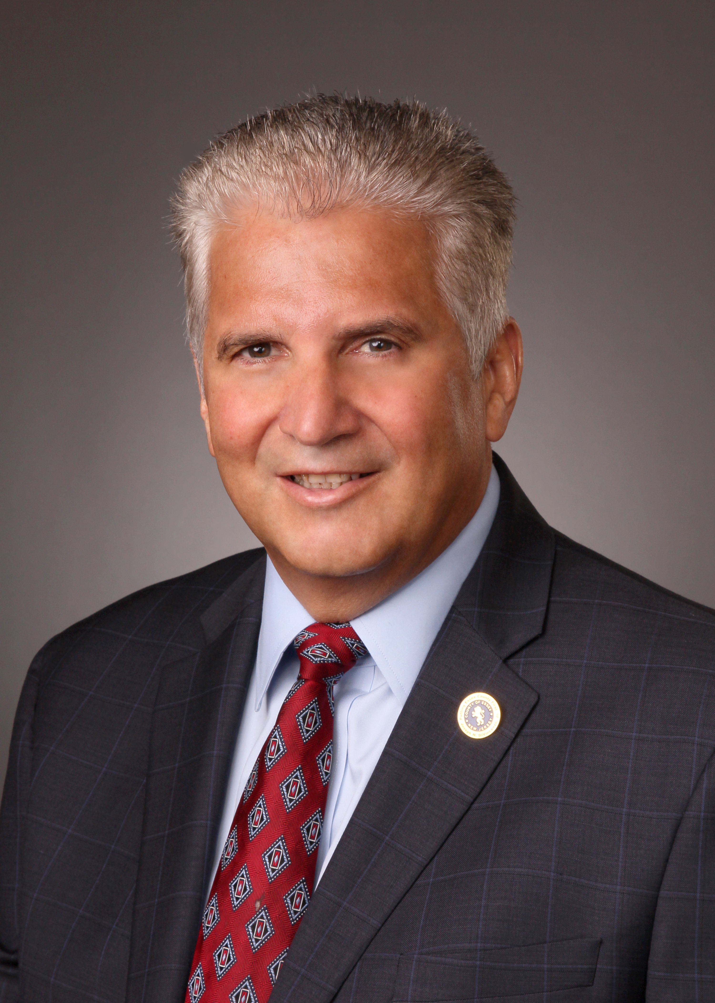
“Getting vaccinated is the best defense against COVID, measles, and many other childhood diseases. We look forward to working with our partners in the Municipal Health Offices to reach the VFC program-eligible children and make sure they have access to the vaccines needed for school.”
Joseph N. DiVincenzo, Jr.,
Essex County Executive

Slide 3
Agenda
Welcome - Maya Lordo, Essex County Health Officer
Joseph Zarra, Essex County Superintendent
Measles Outbreak – Dr. Uzma Hasan, Division Director of Pediatric Infectious Diseases
VFC Overview – Toye Kirkland, Essex County VFC Coordinator
HPV Presentation – Dr. Rosenblum, Essex/Passaic Wellness Coalition
Questions & Closing Remarks
Notes:
Brief Bio on Uzma

Slide 4
Measles
Uzma Hasan, MD
Division Director, Pediatric Infectious Diseases
Cooperman Barnabas Medical Center

Slide 5
Objectives
Outbreaks
Epidemiology
History and clinical exam
Diagnosis and treatment
Vaccination
Reporting
Care of exposed

Slide 6
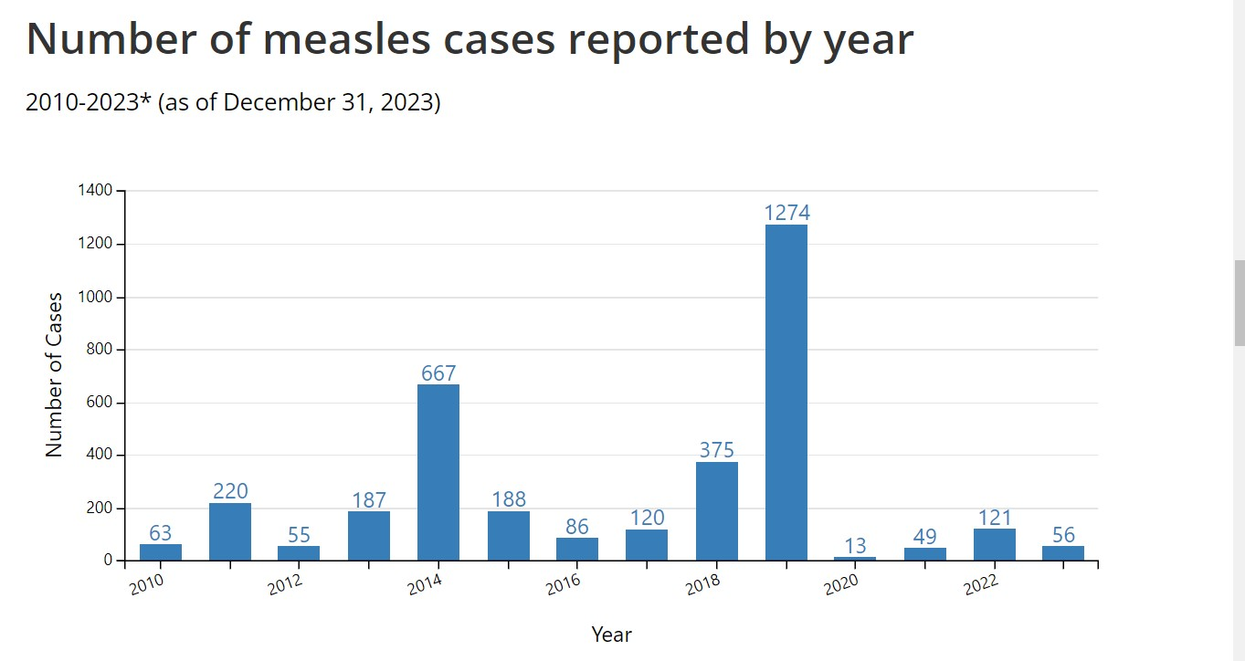

Slide 7
Current outbreak
23 cases between Dec 2023 and Jan 23, 2024.
PA, NJ, Delaware, DC CDC website lists Georgia and Missouri as well
7 international travel, 2 outbreaks 5 or more cases
Most in unvaccinated.
Measles outbreak in Philadelphia
Camden county case
Had 1 dose vaccine, serology showed not protected.
The individual was subsequently confirmed to have measles via positive measles PCR results.
While infectious, the individual visited two health care facilities on Jan. 5 and Jan.8.
The time and place of the visits were:
• 1/5/2024, 11:30 AM – 2:40 PM Cooper Pediatric Care at Voorhees, 6400 Main St, Voorhees Township, NJ 08043
• 1/8/2024, 8:00 PM – 1:00 AM Emergency Department at Jefferson Stratford Hospital, 18 East Laurel Road, Stratford, NJ 08084 The case attended daycare, however, it is believed that anyone that may have been exposed in this setting has been identified and notified.
NJDOH identifying close contacts
As of January 13, 2024, no additional cases have been identified.
Secondary cases would be expected to occur no later than February 2

Slide 8
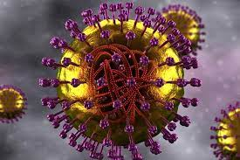
Epidemiology
Measles virus is an enveloped RNA virus with 1 serotype, classified as a member of the genus Morbillivirus in the Paramyxoviridae family
Humans only natural host
Spread droplet/airborne
Attack rate: 90%
Population immunity as high as 95% or greater is often needed to stop ongoing transmission
Late winter and spring

Slide 9
Measles- Clinical features
Fever
Cough
Coryza
Conjunctivitis
Koplik spots
Maculopapular rash
Atypical presentations
Severe illness in immunocompromised hosts
Neurological findings
Complications: otitis media, pneumonia, croup, diarrhea

Slide 10
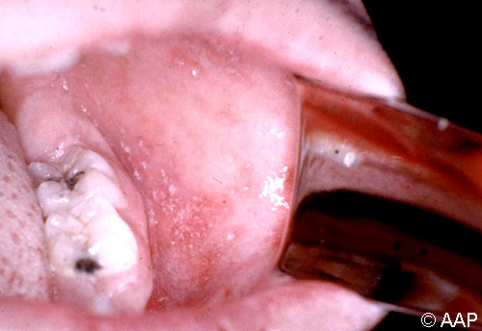
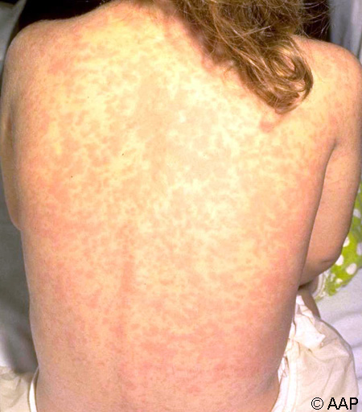
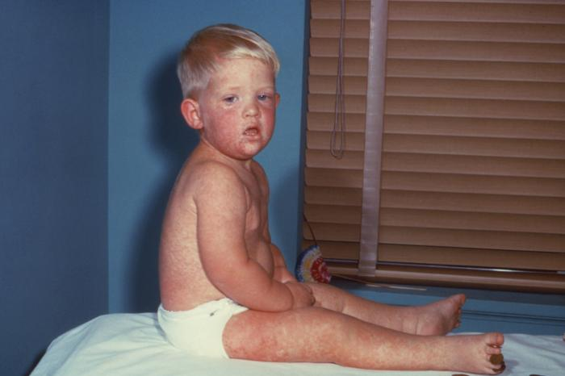
Koplik spots: prodromal phase
Contagious from 4 days before the rash through 4 days after appearance of the rash
Incubation period: 6-21 days.

Slide 11
Diagnosis
Oropharyngeal/nasopharyngeal swab (rRT-PCR)
Urine (rRT-PCR)
Serum (measles IgM and IgG)
TREATMENT
Supportive care
Vitamin A

Slide 12
Reportable illness
NJDOH at (609) 826-5964 during regular business hours
(609) 392-2020 after business hours or on the weekend.

Slide 13
Measles vaccination
Measles vaccination licensed in 1963
99% reduction in cases, no longer endemic in 2000
Inadequate response to vaccine (ie, primary vaccine failure) occurs in as many as 7% of people who received a single dose of vaccine at 12 months or older
Single dose: 95% protection, 2 doses: 98% protection
12-15 mo, 4-5 years
Travel
https://www.cdc.gov/vaccines/vpd/mmr/public/index.html#:~:text=CDC%20recommends%20that%20people%20get,date%20on%20their%20MMR%20vaccination.

Slide 14
Care of exposed
<6 months
6-11 mo
>12 mo
Adult
Immunocompromised
Pregnant
https://www.nj.gov/health/cd/documents/topics/measles/clinical_quick_guide.pdf

Slide 15
References
https://cdc.gov/vaccines/vpd/measles/index.html
https://www.uptodate.com/contents/measles-clinical-manifestations-diagnosis-treatment-and-prevention
https://www.cdc.gov/measles/cases-outbreaks.html
https://www.nj.gov/health/cd/topics/measles.shtml#:~:text=Alert,in%20NJ%20since%20March%202023.
Red book online
Up to Date

Slide 16
VFC – Eligibility Requirements
Children through 18 years of age (up to the day before their 19th birthday) and meet one or more of the following:
Medicaid eligible or NJ Medicaid FamilyCare Plan A
Uninsured - A child who has no health insurance coverage
American Indian or Alaskan Native

Slide 17
COVID-19 (Moderna mRNA ) DTaP (age 6yrs+) DTap-HepB-IPV DTap-IPV DTap-IPV/Hib (Pentacel) DTaP-IPV-Hib-HepB (Vaxelis) DT (through age 6yrs) HPV9 Hepatitis A Hepatitis B | Influenza IPV (Polio) MMR MMR/V Meningococcal B MCV4 PCV15 TD TDap Var

Slide 18
Current Screening Process
Patients are rescreened for VFC program eligibility, vaccinated, and are provided a proof of vaccination
Eligibility
Patients are screened for age & insurance status
Procurement of Vaccination Records
Patients are asked to provide all historic vaccination records
Translation of Vaccination Records
Meet with ECRNs to decipher medical records
Meet with ECRNs to determine what vaccines are required based on vaccination records
Clinic Day
Vaccination Record Overview
1
2
3
4
5

Slide 19
Translation of Vaccination Records
To prevent:
Misinterpretation of vaccine records
Improper vaccination of children
Our Protocol:
School nurse's review the children's vaccine records and provide the immunization portion of the A-45 form to parents/guardians to submit to OPHM

Slide 20
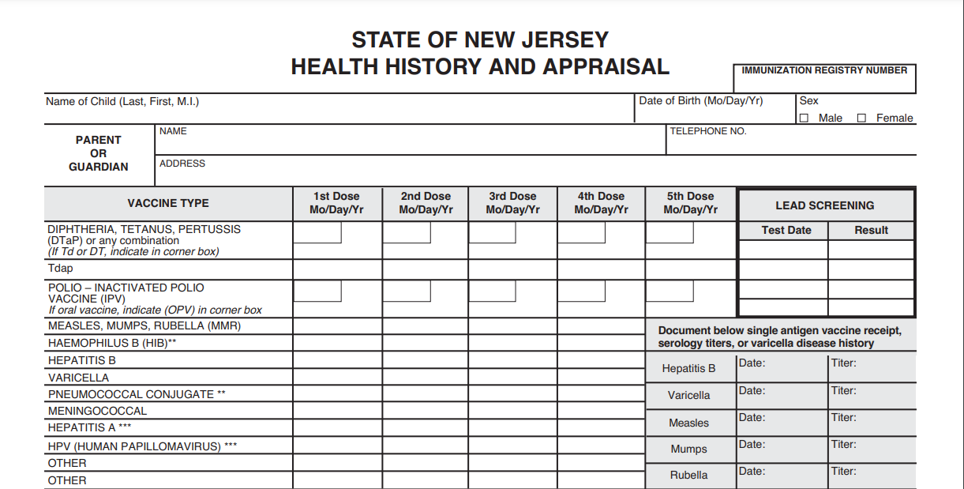

Slide 21
How to Provide a Historical Vaccine Record
Parent/Guardian Submit Vaccine Record
School Nurse Submit Vaccine Record
E-mail directly to OPHM
Instruct Parent/Guardian to call:
973-877-8456
Interpretation Services Available
VFC@essexcountynj.org
Subject: Request Vaccine Appointment + Township & School
Attach A-45 Form as a PDF
Include parent/guardian contact information
List the vaccine required for school

Slide 22
Upcoming Clinics
Schedule an Appointment at EssexCountyNJVaccination.org
or
973-877-8456
38 Conger St, Bloomfield
Tuesday, February 6
38 Conger St, Bloomfield
Wednesday, February 21
291 Union Ave, Irvington
Tuesday, March 5
38 Conger St, Bloomfield
Wednesday, March 20
291 Union Ave, Irvington
Tuesday, April 2
3 PM – 7 PM
3 PM – 7 PM
3 PM – 7 PM
3 PM – 7 PM
3 PM – 7 PM

Slide 23
How We Help You
NJIIS Access
Mobility
Documentation
Our staff has access to the New Jersey Immunization Information System to research historical doses and upload vaccine doses to patient profiles.
Our mobile clinic can travel all over Essex County to host VFC clinics at community centers and schools.
Each patient will leave with a record of vaccination and/or a future appointment confirmation letter with an Essex County Office of Public Health Management stamp and nurse's signature.

Slide 24
CONTACT INFORMATION
To Schedule the Mobile Clinic:
To Make VFC Appointments:
To ask General VFC Questions:
Allison Quaye
Mobile Clinic Coordinator
Aquaye@dchs.essexcountynj.org
Call Center
973-877-8456
Essexcountynjvaccination.org
Toye Kirkland
VFC Coordinator
862-231-2863
Tkirkland@dchs.essexcountynj.org
Notes:
HPV PRESENTATION

Slide 25
Cancer prevention by HPV vaccination
Presentation to Essex County school nurses
by Essex-Passaic Wellness Coalition as part of
Vaccines for Children event
Monday, January 29, 2024
About the EPWC: epwcnj.org Facebook @EssPasNJWell; X (formerly Twitter) @EssPasWell; Instagram @epwcnj; LinkedIn epwc

Slide 26
Cancer prevention by HPV vaccination
HPV is the human papillomavirus.
There are well over 100 different strains/types!
Best done at ages 9–12!
WHY? We’ll discuss that…
Only TWO doses needed IF started before 15th birthday

Slide 27
9-valent HPV vaccine prevents cancer
The only HPV vaccine NOW being marketed in US is the 9-valent (Gardasil 9).
Includes the 7 HPV types that cause the most HPV-related cancers in the US, thus providing protection against
Cervical cancer,
Anal cancer,
Vaginal cancer,
Vulvar cancer,
Penile cancer,
Oropharyngeal cancer.
This is what most parents care about!
PLUS protection against the 2 most common HPV types that cause anogenital warts.
This has contributed to the children being interested.

Slide 28
CDC Recommendations (also ACS & others)
HPV vaccine should be routinely given at age 11–12.
Can start as early as age 9.
Vaccine prevents infection by a given HPV type only if given before infection with that HPV type, so best to vaccinate before any HPV exposure or infection is likely to have occurred.
Initiation of some sexual activity – touching, oral or genital – often begins much earlier than parents realize, and the vaccine should be given in advance and it gives extended protection.
If started before 15th birthday, need two doses, 6 to 12 months apart.
Stronger immune response at these ages than in those who are older.
If start at age15 or older, need three doses 6 to 12 months apart.

Slide 29
Authoritative Resources
American Cancer Society (ACS) has information and educational flyers at www.cancer.org/cancer/risk-prevention/hpv/hpv-vaccine.html.
National HPV Vaccination Roundtable has many resources at hpvroundtable.org, ranging from flyers for parents to detailed reviews of evidence for clinicians.
CDC web site includes:
Information for laypeople at www.cdc.gov/vaccines/vpd/hpv/public/;
Information for healthcare professionals at www.cdc.gov/vaccines/vpd/hpv/hcp/.

Slide 30
Proposed project: school nurses working with FQHCs to directly refer for HPV vaccines
FQHCs in Essex County
Jewish Renaissance Medical Center (in several Newark schools)
Newark Community Health Centers (Newark, East Orange, Irvington, Orange)
Newark Department of Health and Community Wellness
Rutgers – Nursing Faculty Practice (Newark)
Saint James Health, Inc. (Newark)
Zufall Health Center (West Orange)

Slide 31
A useful graphic (English)

Slide 32
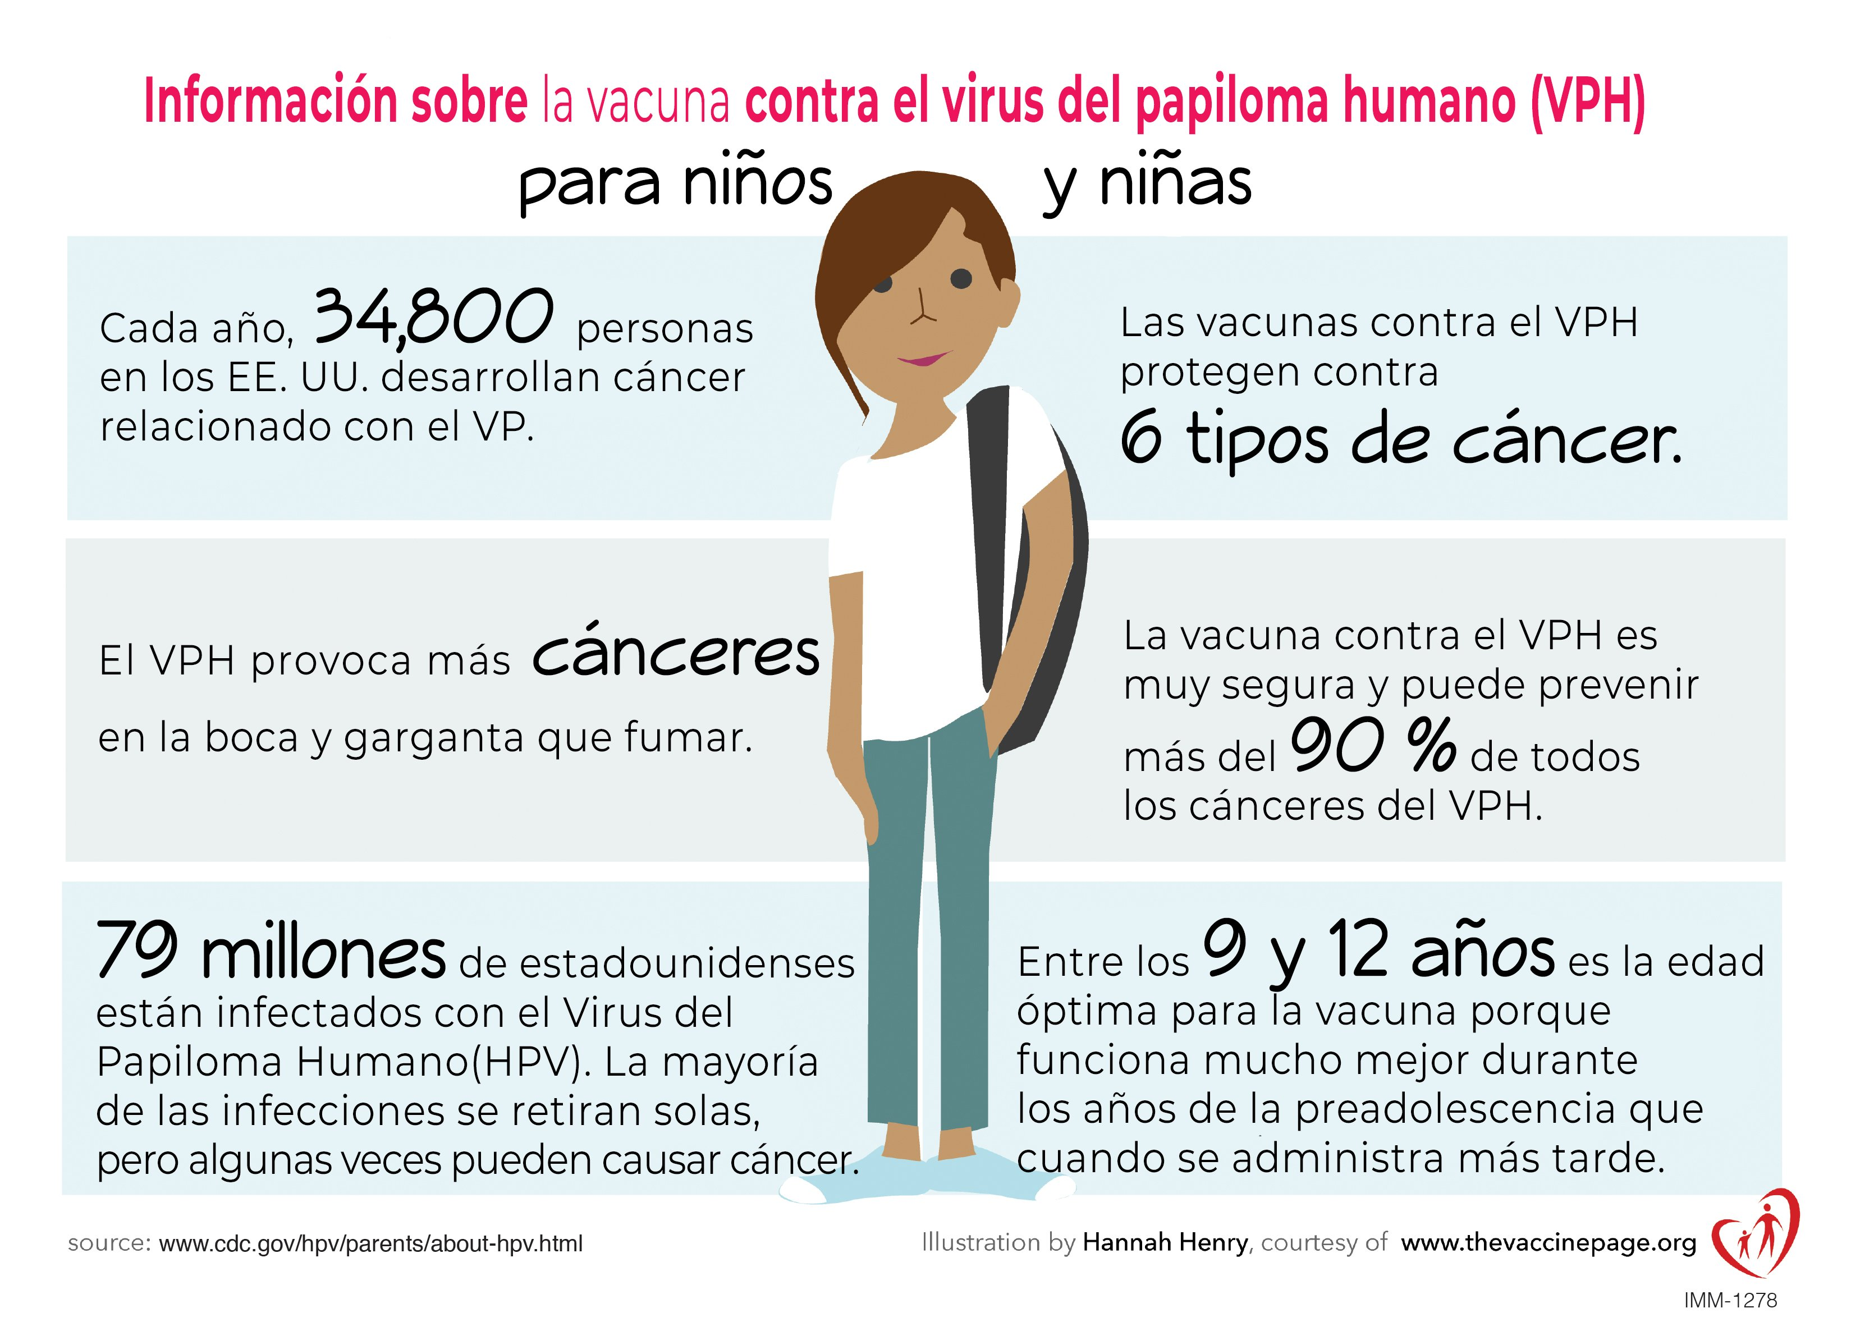
A useful graphic (Spanish)

Slide 33
Questions

Slide 34
Thank you
Essex County Office of Public Health Management
973-877-8456
VFC@essexcountynj.org

